Slide 1
Temperature & Reliability tests
RR
Wk 18 - 2018

Slide 2
Summary
Temperature tests (All in Device ON state) | # of Samples | # of Cycles | Test Status | Test Result | Test Observations
Operation of HMT in -20 Degree | 5 | Once | Completed | Pass
Operation of HMT in -25 Degree | 5 | Once | Completed | Pass
Operation of HMT in -30 Degree | 5 | Once | Completed | Pass
Operation of HMT in -35 Degree | 5 | Once | Completed | Pass
Operation of HMT in -40 Degree | 5 | Once | Completed | Pass
Operation of HMT in +35 Degree | 5 | Once | Completed | Pass
Operation of HMT in +40 Degree | 5 | Once | Completed | Pass
Operation of HMT in +50 Degree | 5 | Once | Completed | Pass
Operation of HMT in +60 Degree | 5 | Once | Completed | Partial | Device becomes sluggish (~50% of the voice commands not recognized)
HMT Device Moving from -20 to +20 degrees | 5 | Once | Completed | Pass
HMT Device Moving from +20 to -20 degrees | 5 | Once | Completed | Pass
HMT Device Moving from -40 to +60 degrees | 5 | Once | Completed | Partial | Device becomes sluggish (~50% of the voice commands not recognized)
HMT Device Moving from +60 to -40 degrees | 5 | Once | Completed | Pass
2m Drop test (Hard hat)
Drop test (Hard hat) in HMT ON state | 4 | 1 cycle x 6 positions | Completed | Pass | Hard hat broke & Clips deformed but no issues on HMT
Surface Temperature tests
After 1 hr Video recording | 1 | Once | Completed | Pass
After 1 hr Video recording @ 50 deg C | 1 | Once | Completed | Pass
Reliablity Tests
Tumble test | 1 | 50 | Completed | Fail | Could not close Headset port rubber cover
Mechanical Tests
Bending | 2 | 15,000 | Started | Complete by 9May | Tests have started Recorded sample Videos
Twisting | 2 | 2,500
Camera Hinge | 2 | 5,000
Shoulder Hinge | 2 | 5,000
Elbow Hinge (Direction 1) | 2 | 5,000
Elbow Hinge (Direction 2) | 2 | 5,000
Display pod (Direction 1) | 2 | 5,000
Display pod (Direction 2) | 2 | 5,000
Display pod (Direction 3) | 2 | 5,000

Slide 3
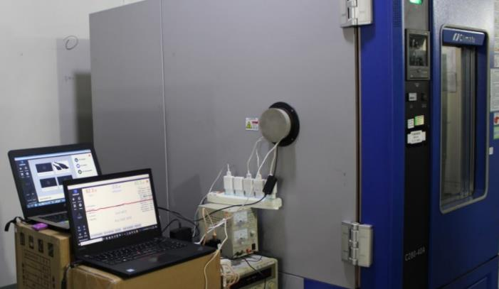
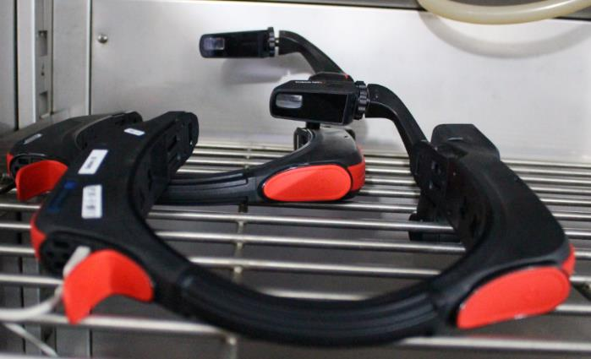
Temperature tests
Performed all peak level temperature tests
Test samples: 5 devices (Each test)
Test Setup
All 5 devices placed inside temperature chamber
Wait 1 hr after reaching desired temperature
2 HMT devices connected to 2 laptops via USB cable
On 1st HMT device sample, Copied Video file & Audio file (containing recorded Voice commands)
MIC of 2nd HMT placed near speaker of 1st HMT device
Voice commands played from 1st HMT was picked by 2nd HMT and actions were performed inside the chamber
Checked out standard Audio test using Speech tester to check the # of Voice commands recognized
Sample 1
Sample 2
Verification steps | Tested Inside/Outside chamber
• Check if the display is clear and visible | Outside chamber
• If voice commands are working | Inside chamber
• If speaker is working | Inside chamber
• Play video (record or streaming) for 1 min | Inside chamber
• Heads gestures are working | Inside chamber
• If able to connect to Wifi Network | Couldn’t test - No Wifi available
• If GPS is working fine | Outside chamber

Slide 4
Temperature tests - Observations
No issue with the physical appearance of HMT device after each temperature test
At 60degC, HMT becomes sluggish (Half of the voice commands were not recognized)
Once the temperature cools down, the device gets back to normal performance
Videos at https://1drv.ms/f/s!AqIWGJqrJmyUi6IfOuKGW5futGdb9A (Full size ~10GB)
https://1drv.ms/f/s!AqIWGJqrJmyUi6IgNpc6TOpfyA6dJA (Compressed for quick view)
Sl | Temperature Tests | # of samples tested | # of hits recognized (Out of 13) | Avg Conf level
1 | Operation of HMT in -35 Degree (Device ON state) | 5 | 12 | 5339
2 | Operation of HMT in -40 Degree (Device ON state) | 5 | 11 | 4973
3 | Operation of HMT in +35 Degree (Device ON state) | 5 | 13 | 5709
4 | Operation of HMT in +40 Degree (Device ON state) | 5 | 13 | 5728
5 | Operation of HMT in +50 Degree (Device ON state) | 5 | 12 | 5612
6 | Operation of HMT in +60 Degree (Device ON state) | 5 | 7 | 5779
7 | HMT Device Moving from +20 to -20 degrees (Device ON state) | 5 | 11 | 5073
8 | HMT Device Moving from -40 to +60 degrees (Device ON state) | 5 | 7 | 4632
9 | HMT Device Moving from +60 to -40 degrees (Device ON state) | 5 | 13 | 5126

Slide 5
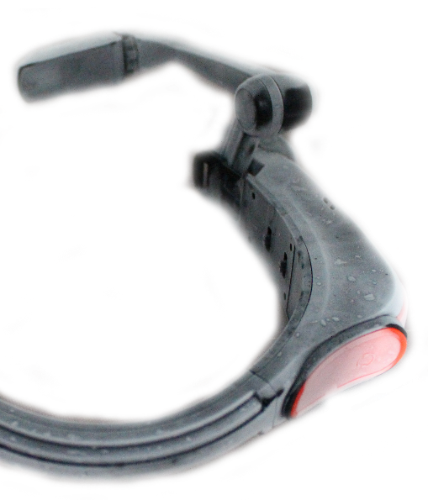
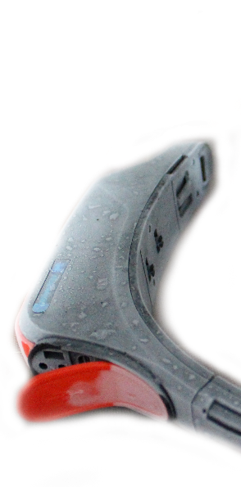
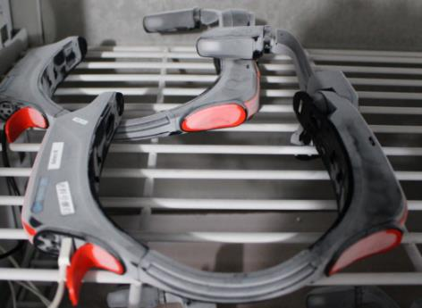
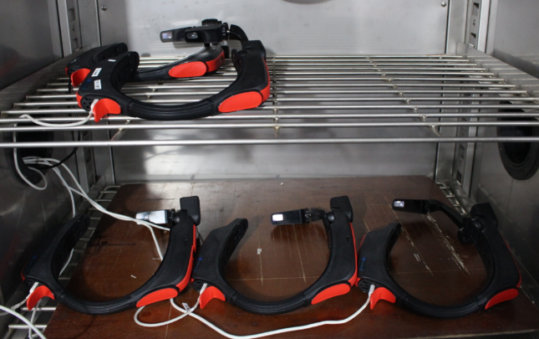
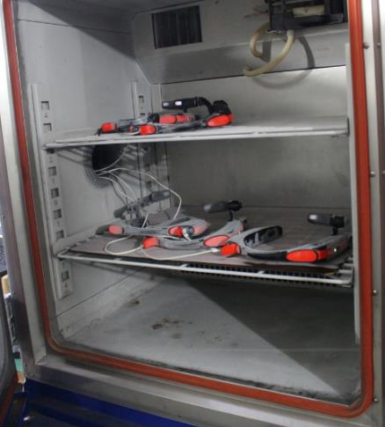
Temperature tests - Pictures

Slide 6
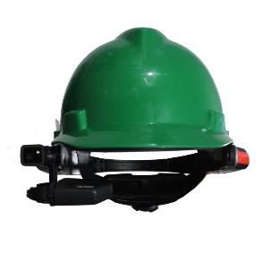
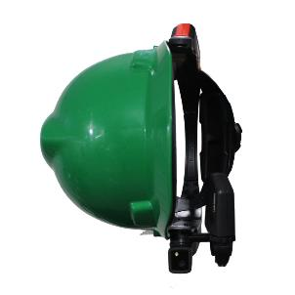
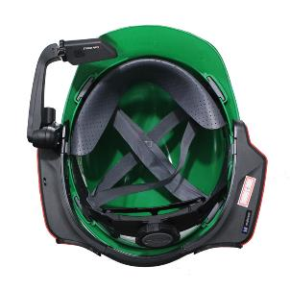
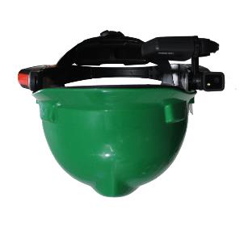
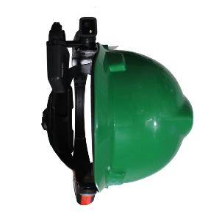
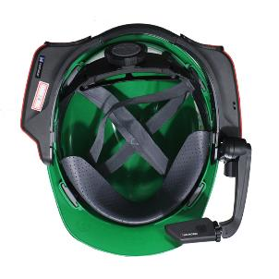
2m Drop tests (with Hard hat)
Freefall drop of HMT (In ON state) latched to Hard hat at 2m distance on Concrete floor
Test Samples: 4 devices x 1 Cycle (1 cycle = drop once in all 6 positions)
1 Cycle drop test (6 positions)
Test Position
❶
❸
❺
2m
❷
❹
❻
Concrete Floor

Slide 7
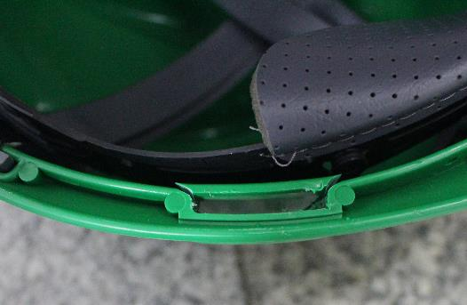
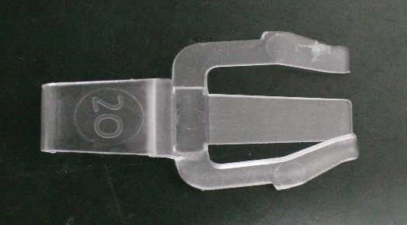
2m Drop tests (with Hard hat) - Observations
Almost after every drop the clips jumped out of HMT separating the device from Hard hat
During 1st device drop test
Hard hat cracked making it unusable to use the clips
(So we had to use some other connecters to connect HMT to Hard hat)
One of the clip deformed
HMT device was perfectly OK
No damage to the HMT device
Display clear & visible
Device responds to the Voice commands
Speakers works
Head gestures were works fine
SD card works fine without any disconnect
GPS worked fine
Videos of the drop test
https://1drv.ms/f/s!AqIWGJqrJmyUi6IAUSByyQpDM289mQ (Compressed for quick view)
https://1drv.ms/f/s!AqIWGJqrJmyUi6ICWXrIjyEpmwp-NQ (Full size > 3GB)
Hard hat broken
Clip deformed

Slide 8
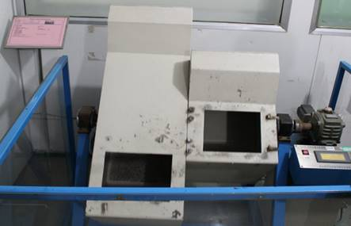
Tumble Test
Tumble test will expose device to ‘random free-fall’ drop inside 1m metal box
Test Samples: 1 device x 50 Cycles (total 100 drops)
After every 10 cycles the device is taken out and checked for physical impact and functional check
Equipment used

Slide 9
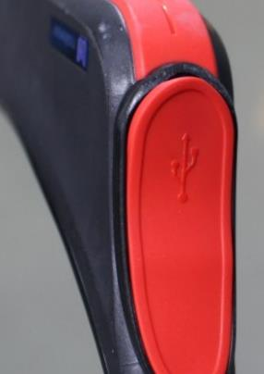
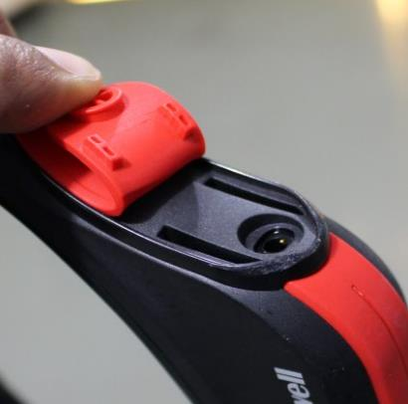
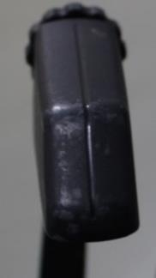
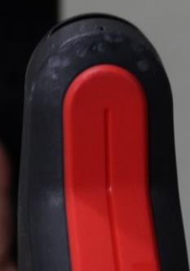
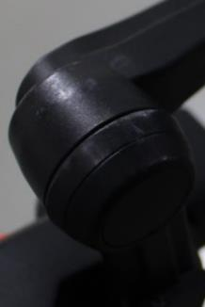
Tumble Test - Observations
No break on the HMT device
There were minor dents across the devices
The plastic supporting the Charging port & Headset rubber cover were deformed. We could still close the Charging port rubber cover, closing the Headset port rubber cover failed
Functionally the HMT performed well
Checked Voice commands, Speaker after the test, No issues observed
Videos
https://1drv.ms/f/s!AqIWGJqrJmyUi6IRpLfFcESfI-2mrA (Compressed for quick view)
https://1drv.ms/f/s!AqIWGJqrJmyUi6IT-D7Y0S90w5lCqg (Full size)
Plastic Deformed
Plastic Deformed
Minor Dents

Slide 10
Mechanical Tests (Twisting & Bending)
Started tests for both Twisting and Bending
Twisting Test samples : 2 devices x 2500 cycles
1 sample illustration
Bending Test samples : 2 devices x 15,000 cycles
1 sample illustration
Video at https://1drv.ms/f/s!AqIWGJqrJmyUi6IU_E8WWNbH7Ubpzw (Full size)

Slide 11
Mechanical Tests (Camera, Shoulder & Elbow hinges)
Started tests for Hinge life tests
Test samples: 2 devices x 5000 cycles
Video at https://1drv.ms/f/s!AqIWGJqrJmyUi6IU_E8WWNbH7Ubpzw
Camera Hinge
Elbow Hinge (Direction 1)
Click on the
Video Samples
☞
Shoulder Hinge
Elbow Hinge (Direction 2)

Slide 12
Mechanical Tests (Display Pod Hinge)
Started tests for Display pod tests
Test samples: 2 devices x 5000 cycles
Video at https://1drv.ms/f/s!AqIWGJqrJmyUi6IU_E8WWNbH7Ubpzw (full size)
Click on the Video Samples

Display Pod (Direction 1)
Display Pod (Direction 2)
Display Pod (Direction 3)

